Slide 1
ETL Project
Ashlee Pounds

Slide 2
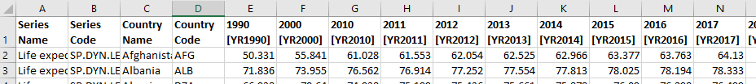
Overview
Data sets from data.world
CSV format, saved in Resources folder
1st Set – Life Expectancy in years for a range of years per country
2nd Set – Smoking Prevalence in percent of population per country
Notes:
-downloaded two CSVs
-The first data set was the smoking prevalence as a percent per country. The second was the life expectance in years per country.
-I was hoping to find a correlation between the two sets by pulling into one table both pieces of data from two different years and seeing if smoking trending down correlated to life expectancy trending up.

Slide 3
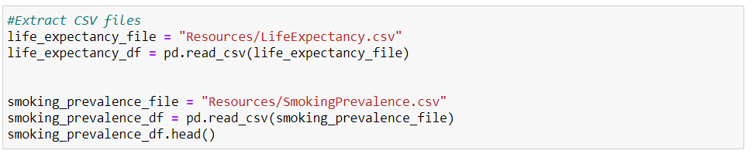
E T L
Extracted CSVs in jupyter notebook with a pandas dataframe
Notes:
- Extracted into CSV

Slide 4
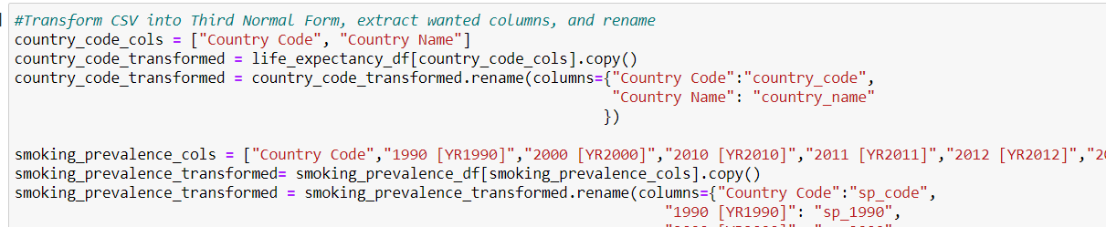
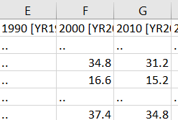
E T L
Put data into Third Normal Form, with separate country code and country name table.
Pulled only the columns wanted into a transformed data frame.
Cleaned the data to replace the blank cells “..” with “NaN”
Sample of data:
Notes:
Third normal form since the data had country code (3 letters) and country name.
Pulled columns I wanted, country code and the years representing columns of data
Cleaned the data by replacing the empty cell double periods with the string “NaN”
Had to use “NaN” because the SQL postgres server utilized this value for null values of a REAL number, this way I could load in the data without getting an error.

Slide 5
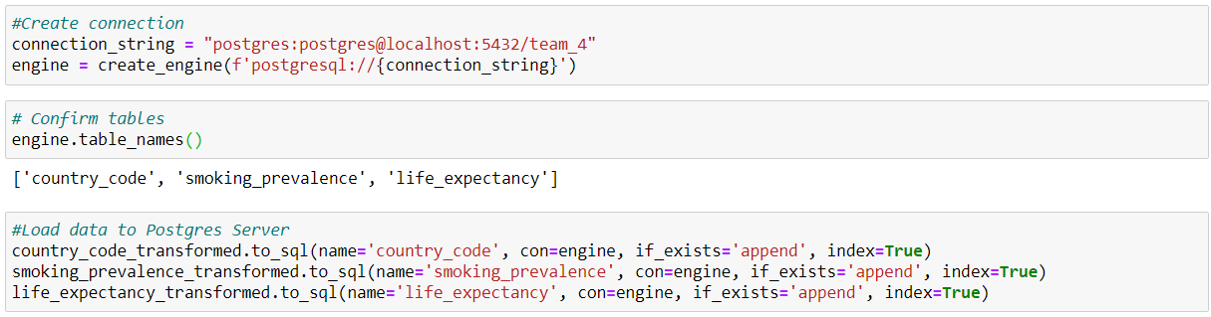
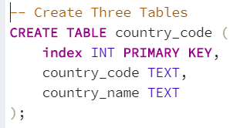
E T L
Schema create to initialize tables with Primary Key values.
Connection to Postgres server established in jupyter notebook.
Dataframes loaded into Postgres server.
Notes:
Initialized table in Postgres, sample on screen
Create connection and load into Postgres

Slide 6
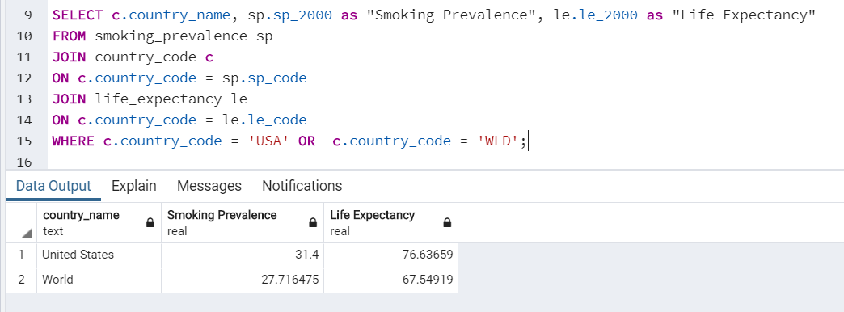
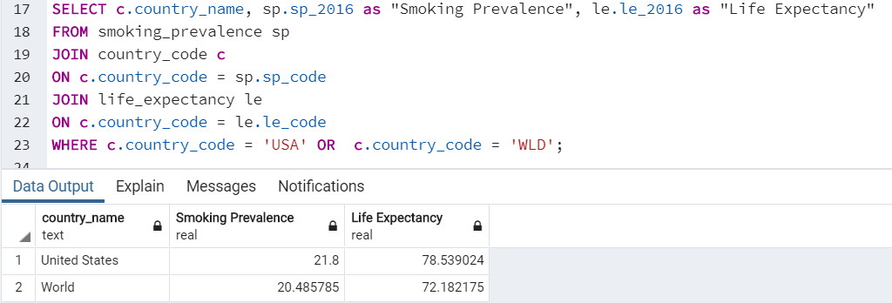
E T L
Two tables pulled using join on the country code
Notes:
- Pulled the US vs the World for the year 2000 and 2016
- RESULT=From the data on the screen, from 2000 to 2016, the US smoking prevalence went down ~10% and the world went down ~7%. Additionally, the life expectancy went up ~2 years in the US and ~4.5 years worldwide.

Slide 7
Questions?

